Slide 1
Example
Dr. A K M Akhtar Hossain

Slide 2
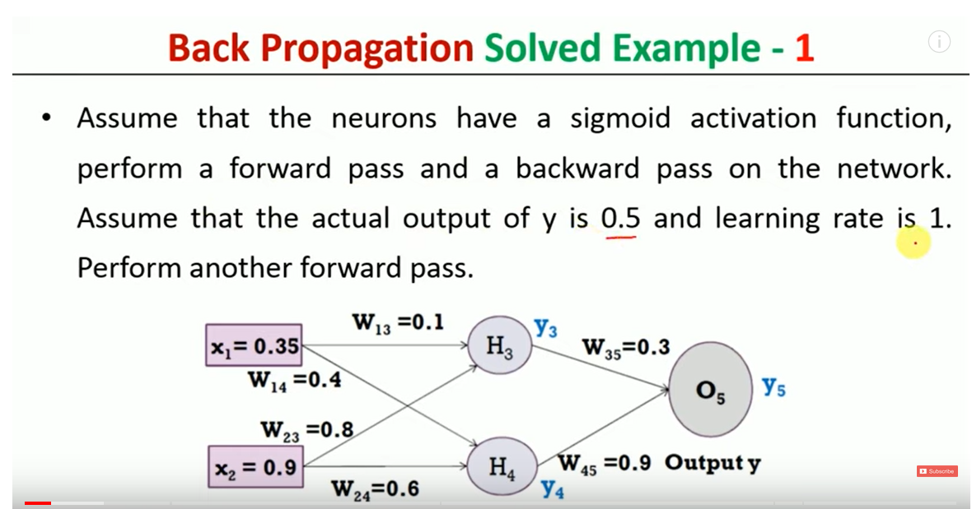

Slide 3
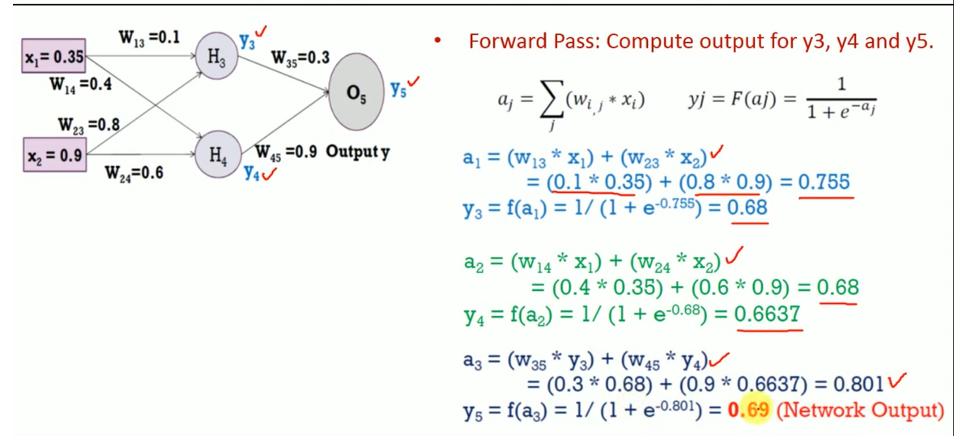

Slide 4
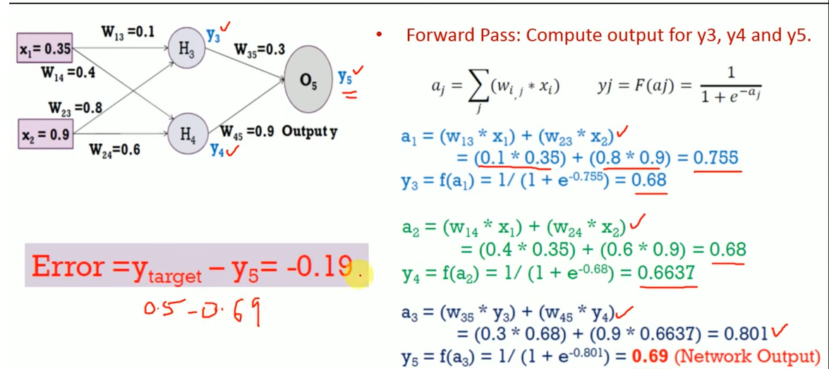

Slide 5
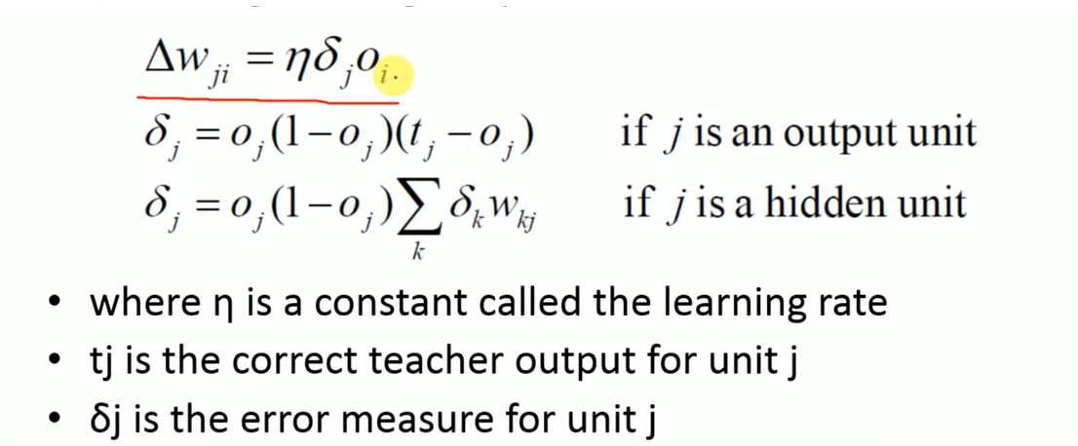

Slide 6
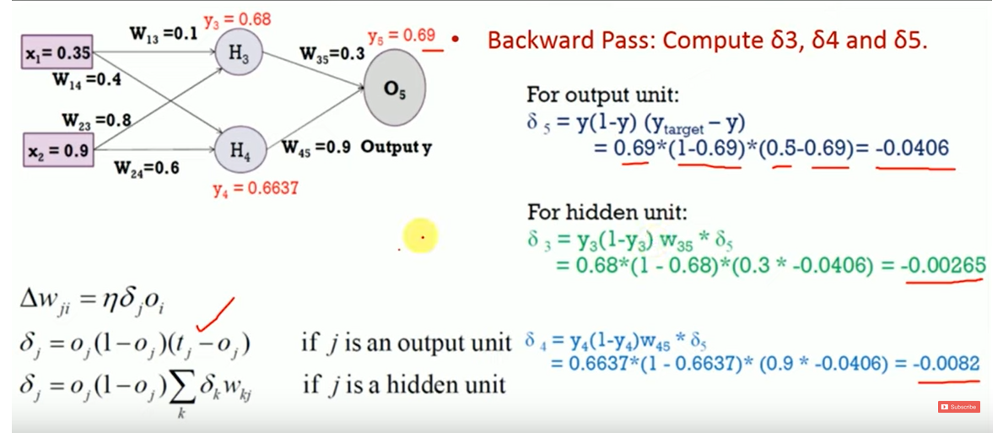

Slide 7
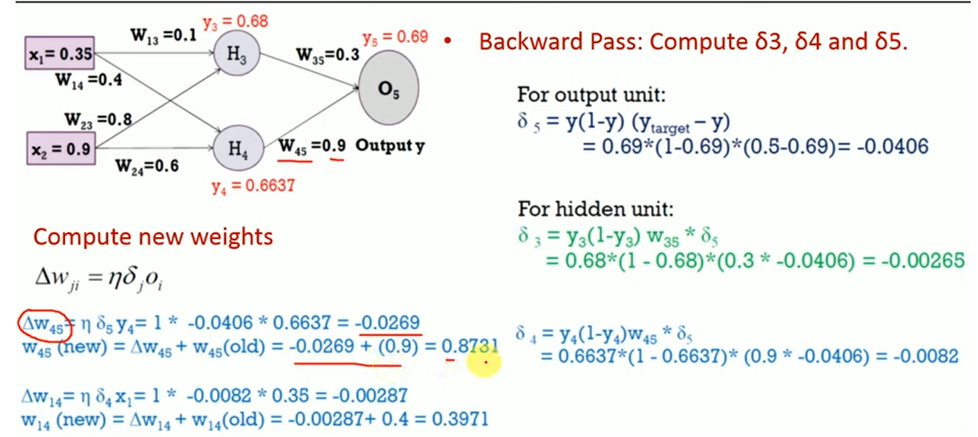

Slide 8
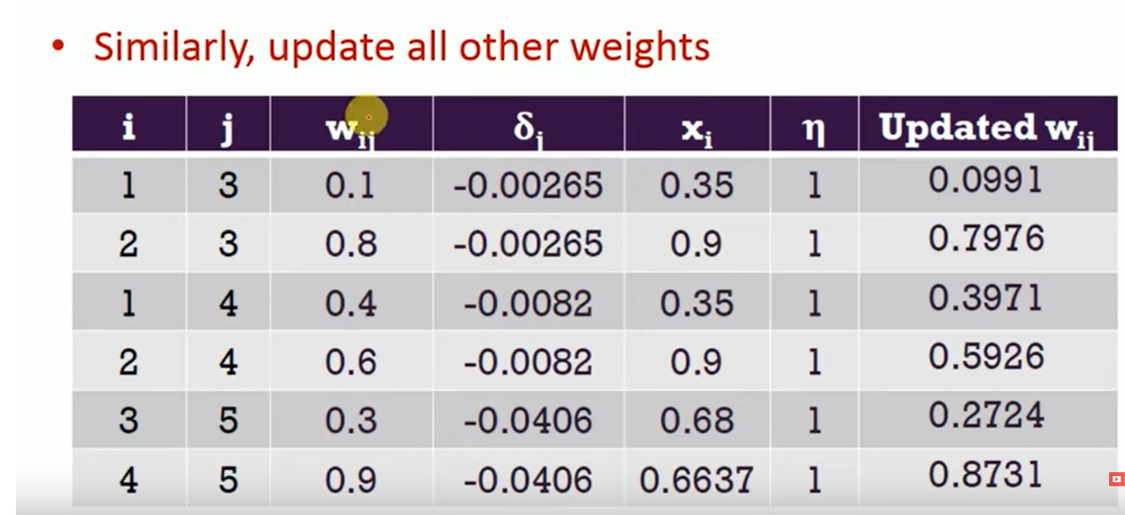

Slide 9
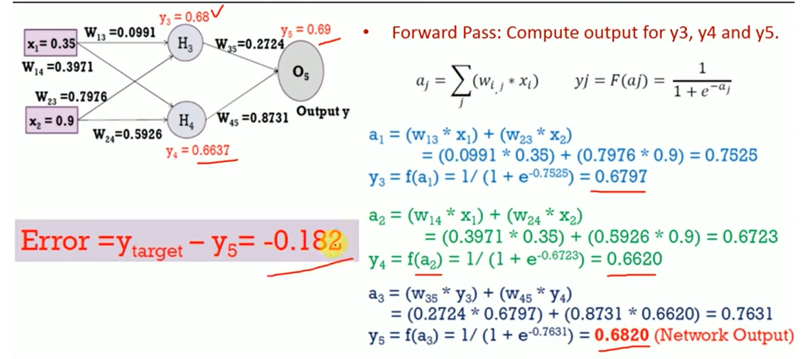

Slide 10
END

Slide 11
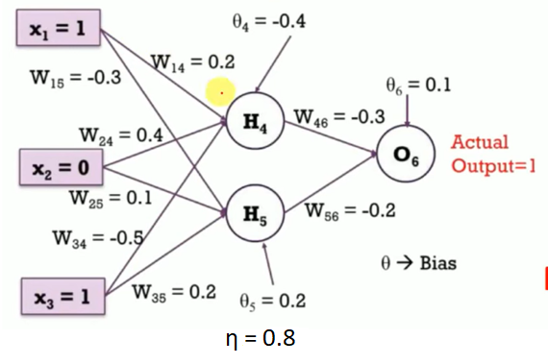
Assignment 01: Last date of Submission: 11/02/2024
Consider the following BPNN with corresponding inputs, weights, bias, learning rate, stopping factor. Calculate the networks Forward pass two times and Backward pass one time and show the possible output.

Slide 12
THE END

